Slide 1
Time-Based Steganography with Dynamic Encryption Key
2540119476 – Bryan Lansky
2540118971 – Kevin Wijaya
2540119186 – Cecilia Ariani Dewi

Slide 2
01
Cryptography
Cryptography derives from Greek, kryptós which means “secret” and γράφειν which means "to write". Combine those two words together, and then it means secret writing.

Slide 3
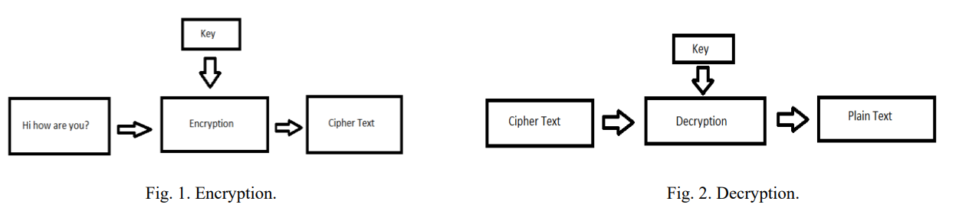
Two Important Terms
Encryption
Decryption
Example encryption algorithm : AES, Blowfish, etc

Slide 4
Encryption Algorithm
AES/ Advanced Encryption Standard
AES is a symmetrical cryptography, which is used to encrypt and decrypt data efficiently. This algorithm uses the same encryption key to encrypt and decrypt data.
Most robust security protocols and one of the popular encryption algorithm.

Slide 5
02
Image
Storage or container
Contains several channel (RGB & ARGB)

Slide 6
03
Steganography
Art to hiding a message into the media like image, video, and sound file.

Slide 7
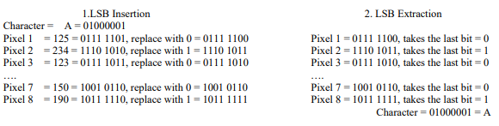
Least Significant Bit (LSB)

Slide 8
04
PSNR Method
PSNR (Peak Signal-to-Noise Ratio) is one of the measurement methods used to measure the quality of images or videos by comparing the original image with the resulting image.

Slide 9
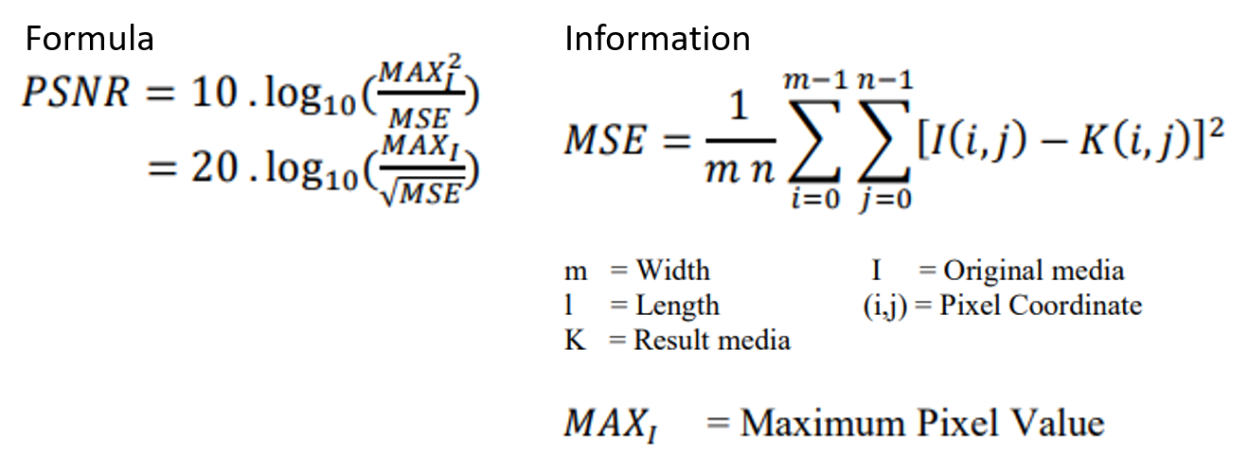
PSNR Method

Slide 10

05
Time
$$\frac{1}{(24∗60)}∗100\% =\frac{1}{1440}∗100\%=0.0694\%$$

Slide 11
06
Length of Key

Slide 12
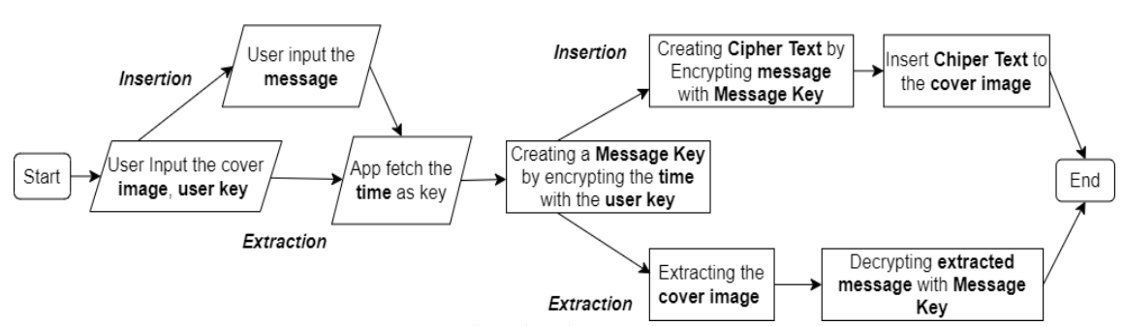
07
Flowchart

Slide 13
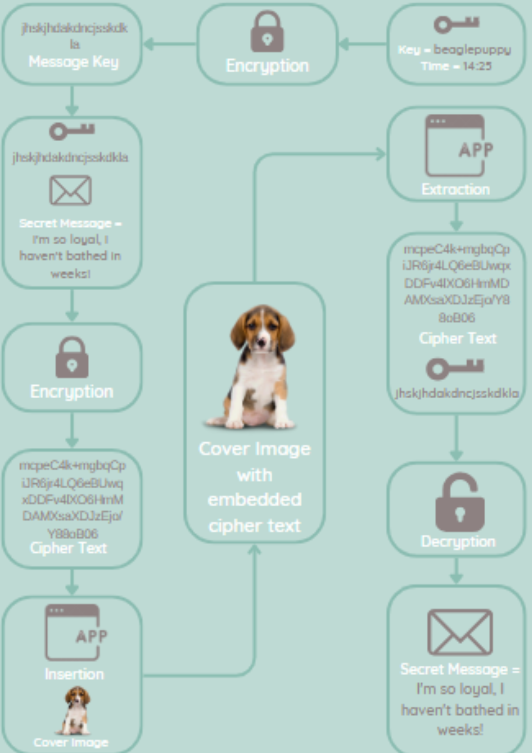

Slide 14
Thanks!

